Slide 1
Twitter Sentiment Analysis Using NLP
by Nikhil Gupta

Slide 2
Project Objective
Data Collection
To classify positive/negative sentiment.
Use different NLP techniques like tokenization, translation & word embedding.
Used hugging face transformer model.
Used ML models like Random Forest, Logistic Regression and XGBoost.
Use SHAP to interpret Business Implications.
The dataset used for this project was sourced from Kaggle.
The dataset comprises of 1.6 million tweets from global users.
It contains following fields-
target: 0 → negative & 1 → positive.
id: tweet.
date: day, date, time & year.
flag: query.
user: username.
text: tweet context.

Slide 3
Data Overview
The text column of dataset consists of tweets. The tweets are not pure.
It consists of special characters, username, punctuations, numerical values, abbreviations.
Some tweets are in different language like German, French, Japanese.
Some tweets are only of one word & some tweets are very large.
It doesn’t contains any garbage like emoticons.

Slide 4
Data Preprocessing
Regex Expression Removal of special char, url’s, digits.
Google Translation Translating non-English words to English.
Tokenization Splitting text by space or periods.
Abbreviation Expansion Using NLTK to expand text.
POS Tagging POS tagging in text column.
POS Count Counting POS & creating features.
Stemming (Porter Stemmer) Reduce word to root word.
BOW Counting frequency of word.
TF-IDF Vectorization Counting frequency & importance of word.
N-Gram Evaluated bigram, trigram & ngram.
Sentence Transformer (BERT) Evaluated text classification & Semantic Similarity.
Text Length Based Feature Adding char count, word count as features.

Slide 5
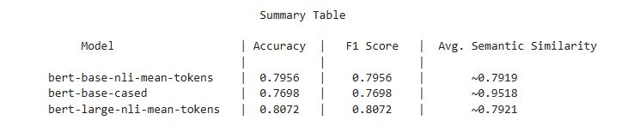
Sentence BERT
On observing the above table we got that bert-large-nli-mean-tokens has highest accuracy and F1-Score (0.8072) making it ideal for text classification. Also bert-base-cased achieved the highest semantic similarity scores (~0.95) demonstrating strong sentence level understanding despite slightly lower classification problem. And bert-base-nli-mean-tokens offered a good trade-off between classification and similarity making it a reliable all-rounder.

Slide 6
Feature Engineering
Applied TF-IDF with 5000 features, kept top 100 features by average value.
Reduced feature count from 10027 features to 5527.
Did the same for n-grams, cut from 5000 to 500 features.
Final feature set: 1027.
Used Random Forest to get feature importances.
Selected top 100 features by importances.
Trained model on sample data of shape (500000, 100).

Slide 7
Model Building
Algorithms: Used Logistic Regression, Random Forest and XGBoost for sentiment
prediction.
Tuning: Employed Randomized SearchCV for hyperparameter optimization.
Data Split: Split data into train and test sets for evaluation.
Metrics: Evaluating Accuracy and F1 Score, ensuring both correctness and balance
between precision/recall.
Visualization: Plotted classification reports to analyze performance across sentiment
analyses.

Slide 8
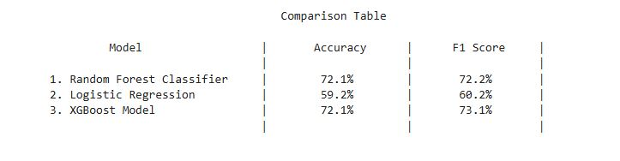
Model Performance
XGBoost and Random Forest both achieved 72.1% accuracy, but XGBoost had a slightly better F1 score (73.1% vs. 72.2%), indicating better precision-recall balance. Logistic Regression performed significantly worse, with 59.2% accuracy and a 60.2% F1 score, suggesting it couldn't capture complex patterns as well as the tree-based models. Overall, XGBoost is the preferred model due to its stronger F1 score and consistent accuracy.

Slide 9
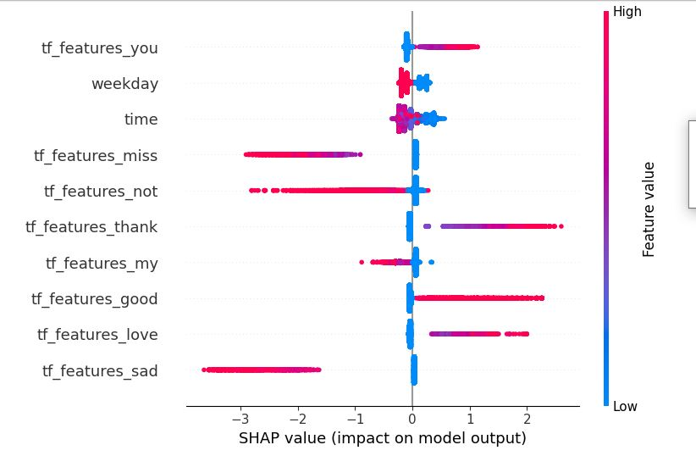
Shap Explainability
It helps stakeholders understand which features influence the prediction.
It can uncover if the model is unfairly biased, supporting ethical AI development.
SHAP provides human-readable explanations that aligns with business needs.

Slide 10
Features Impact & Insights
Features | Impact | Business Meaning
1. tf_features_you | Increases positive sentiment. | Adds personal touch ------ shows personalization matters.
2. weekday | Pushes the prediction slightly up. | Certain weekdays might correlate with more engagement.
3. time | Slightly positive or neutral effect. | Posting time might slightly influence predictions.
4. tf_features_miss | It has negative effect. | Indicates sadness or longing indicating negative sentiment.
5. tf_features_not | It has negative effect. | Associated with negation or criticism → negative sentiment.
6. tf_features_thank | It has positive effect. | Increase predicted score of the sentiment.
7. tf_features_my | It’s effect is mixed but stable. | It doesn’t have strong predictive power.
8. tf_features_good | It has positive effect. | Leads to higher-sentiment prediction.
9. tf_features_love | It has strong positive effect. | Major positive indicator in model predictions.
10. tf_features_sad | It has a negative effect. | It correlates with lower sentiment predictions.

Slide 11
Use Cases
Customer Feedback Monitoring
Continuously track public perception of products or services through tweets. Business can identify areas of improvement
Campaign Tracking
Evaluate public reaction to marketing campaigns, hashtags or events in real time. Enables quick adjustment for maximum engagement
Market Research
Analyze public opinion trends around industries, competitors or product categories. Provides valuable consumer insights without the need for traditional surveys.

Slide 12
Thank You
Contact Info: 9140609646
Email: nik.gupt007@gmail.com
GitHub: https://github.com/nikhil-g1
LinkedIn: www.linkedin.com/in/nikhil-gupta-62b024210/

